Slide 1
Robust Deep learning Based Satellite Tracking Methodology
COOPERANTS
By Souptik Sen

Slide 2
Contents:
Problem Statement
Dataset
Data Pre-Processing
Proposed DL Architecture
Data Processing
TCN and Multi-Head Cross Attention Architecture
Autoregressive Decoder
Masking of Decoder sequence
Results and Parameter Optimization
Future Work

Slide 3
Problem Statement
Because of the hazards and challenges of the space environment, Satellites are usually exposed to orbit deviation, collisions with debris, or loss of tracking control. Therefore, orbit prediction can be defined as the critical and significant role for satellite monitoring and tracking control to reduce the risk of space debris and satellite malfunction.
This solution proposes a novel orbit prediction approach based on Two Line Element (TLE) Satellite data using A Temporal Convolutional Network based Encoder Decoder Architecture.

Slide 4
Dataset Used
Two Line Elements (TLE) data that is collected by NASA (National Aeronautics and Space Administration) & NORAD (North American Aerospace Defense Command) using Radar is used to send out a single a set of orbital components that has been coded that properly describes the orbit of the satellite around the Earth .
Two Satellites have been used for training our model, namely Vanguard 3 and Explorer 7. The model has been tested on the data of IRIDIUM 7 satellite.
The TLE data, which is the standard data format for Satellite navigation, consists of all the information of the satellite like Satellite Identification Number, launch date etc along with Kepler’s 6 parameters for an astronomical object.

Slide 5
Data Pre-Processing
The dataset consists of Kepler’s six parameters for an astronomical object, namely Inclination (Degrees) , Right Ascension of Ascending Node (Degrees),Eccentricity, Perigee Argument (Degrees), Mean Anomaly (Degrees) and Mean Motion (Revs per day) for each epoch. The position and velocity vectors at each epoch for a satellite are calculated using Lagrange’s equations on these six parameters.
After calculating the position and velocity vectors at each epoch, missing values are determined and filled accordingly by using temporal interpolation to construct an uniformly distributed dataset on a temporal scale. After filling out the missing values, a thorough Fast Fourier Transformation (FFT) is conducted for all the dimensions of the position and velocity vectors to determine the most dominant temporal frequency.
This dominant frequency is used to reconstruct the position and velocity vectors in the form of sine and cosine waves by using reverse FFT, thus switching back from the frequency scale to the temporal scale. These waves are added to our original dataset of position and velocity vectors to prepare our final dataset.

Slide 6
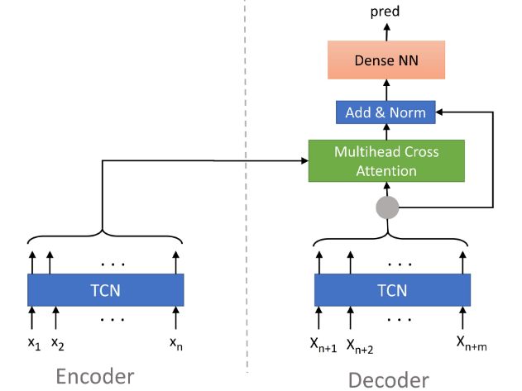
Proposed Architecture
The proposed architecture is a TCN-TCN attention based encoder decoder architecture.

Slide 7
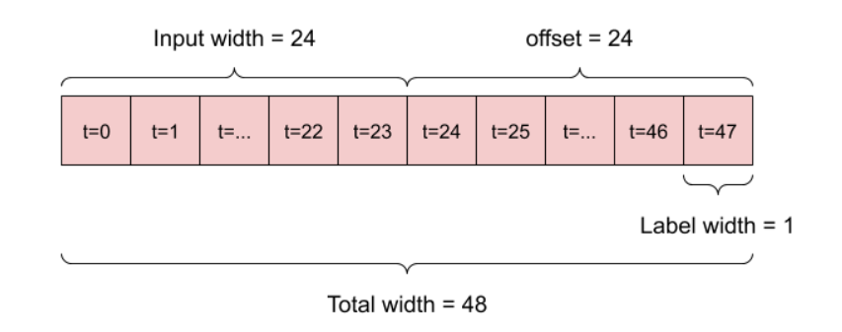
Data processing
The dataset is split into training, testing and validation datasets. The separate datasets are scaled and normalized separately to avoid any kind of overfitting or data anomalies.
The datasets are then windowed temporally by using a sliding window operator function to generate input and target sequences for our model.
The generated sequences are then segregated into Encoder sequence and Decoder sequence.
Encoder sequences~ consists of both the input and target feature values of the input sequences.
Decoder sequences~ consists of the target features values of the target sequences.

Slide 8
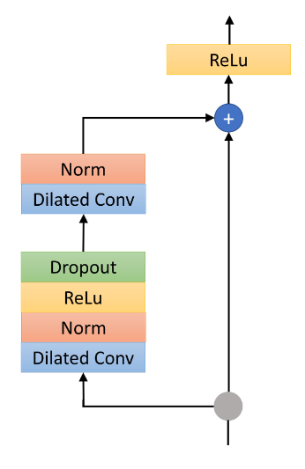
Temporal Convoluted network
One TCN cell (residual block) is structured like this (when choosing ReLu as activation function).
The TCN blocks use as many layers as needed to get a connection from first timestep's input to last timestep's output i.e the number of layers are determined by the number of timesteps in our training dataset.

Slide 9
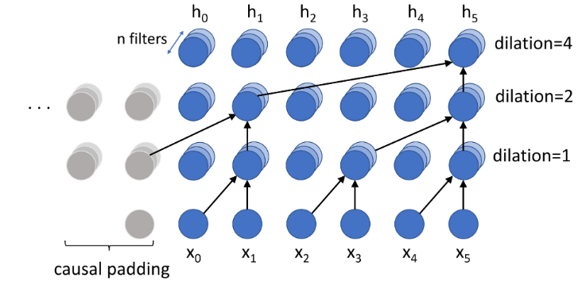
Up Close Dilated Convolutions with Causal Padding
Causal Padding : Output at time t is convolved only with elements from time t and earlier (0 to t-1) in the previous layer. In order to achieve this, zero padding of length (kernel size − 1) is added to keep subsequent layers the same length as previous ones.
Dilated Causal Convolutions: Dilation is equivalent to introducing a fixed step between every two adjacent filter taps. When d = 1, a dilated convolution reduces to a regular convolution. Dilation exponentially increases the receptive field of a TCN.

Slide 10
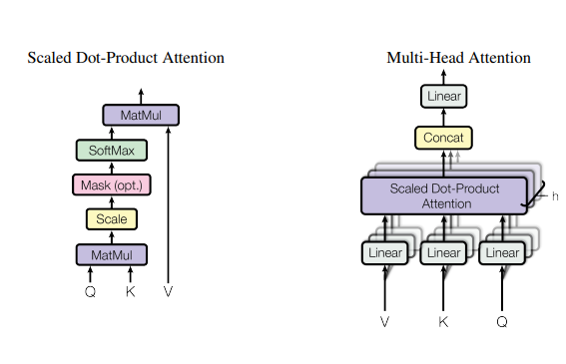


Multi-Head cross Attention
K - Key
V - Value
Q - Query

Slide 11
AutoRegressive Decoder
Autoregressive Decoder:
For training, teacher-forcing is used for the decoder. In addition to other decoder input data that is defined by the user, always the ground truth of the previous time step is added as an additional feature. For example at position x(n+1) the ground truth at position x(n) is added as an additional input. During inference, the predictions of the previous time step is used instead. The autoregressive model can be trained fast in a parallel way.

Slide 12
Masking of Decoder Sequence
As mentioned earlier, the training of this model is done by using teacher-forcing i.e in an autoregressive manner. But when dealing with low amounts of data like real-world satellite navigation data , this can easily lead to overfitting to the decoder input sequences without using the multi-head cross attention layer.
To counter this problem , the decoder input sequences are deliberately perturbed by randomly changing one randomly selected feature vector at each epoch of the decoder input sequences with a random value. This makes the model more dependent on the encoder output and counters overfitting, making the model extremely robust to new types of data( for eg. different satellite data) and high learning rates.

Slide 13
Results
This model has achieved a best MSE loss of 0.0136 and MAE loss of 0.0670 on validation datasets of Vanguard 3 and Explorer 7 satellites.
The model has achieved a R-squared value or goodness of fit of 96% across training datasets of both satellites, making this model very robust for a general purpose satellite tracking model.
(I will include better graphs and visualizations in the following weeks if anyone is interested).

Slide 14
Parameter Optimization
Wrapper classes are included in this model to automate hyper-parameter tuning. Bayesian Tuner has been used to find the best possible hyper-parameters based on the validation loss of the dataset over a specified number of trials. The different hyper-parameters include key/value size of multi-head attention layer, kernel size of TCN layer etc.

Slide 15
Future Works
The future works of this project include :
Uploading the model to a cloud-based architecture.
Building a ML-pipeline to automate the prediction process.
Developing microservices to deploy the model and databases.

Slide 16
Thank you for your Attention!

